Slide 1
Capstone of Poornima R
Statistics & Modeling
Coding with Performance on Big Data
Communicating Results for Decision-Making
Venn Diagram of Data Science Skills

Slide 2
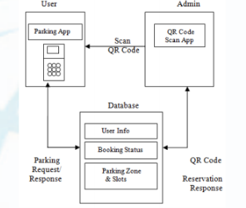
Contribution of Competitor’s Article
Competitor Article
-Smart Parking System Based on Reservation(SPSR)
With the increase in economic behavior and upgrade of living standards of people around the world the ratio of the people who own the motor vehicles and cars have increased. This has increased the traffic congestions on the streets.
According the study of the Union of Concerned Scientists (UCSUSA) 60 percent of traffic congestion on the street . Further the council also stated that the 80 percent of air pollution is caused by the search for parking.
The authors hence proposed a system named SPSR which can collect an effective parking management.
Proposed system

Slide 3
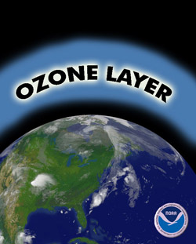
Description of Your Contribution
There has been a number of summits and conferences where the topic of climate is discussed and many pacts are signed across the world to work on the environment.
My contribution is to use the data generated from the Parking Management systems and combine it with the data generated by the pollution department to identify the areas where the pollution is high.
For this I used 1. Multiple Linear Regression and 2.Time Series to fit a predictive model and identify the reasons which was caused the pollution.
We chose the ozone layer as the dependent variable for our analysis.
Notes:
Ozone is a component in the atmosphere which forms a blanket around the surface of the earth which limits the impact of the ultra violent rays on the earth’s atmosphere

Slide 4
Data Source and Content
We used the Parking and Pollution data set given by the city administration of Aarhus city Denmark. Aarhus is a smart city.
The Parking Data Set consists of 1. Vehicle Count 2. Total Space 3.GarageCode.
The pollution data set consists of 1. Ozone 2.Sulpur Dioxide 3. Particulate matter 4.Nitrogen Dioxide and Carbon Monoxide.
Link:
http://iot.ee.surrey.ac.uk:8080/datasets.html

Slide 5
Your Method
Our algorithm consists of running a linear regression and a time series analysis
With linear regression we can fit a predictive model with the dependent and independent variables. We took the “ozone” field as the dependent variable and the “vehicle count,” “total spaces,” and “garage code” as the independent variables.
We then performed the time series analysis to get a better understanding of the impact that our variables had on the ozone layer.

Slide 6
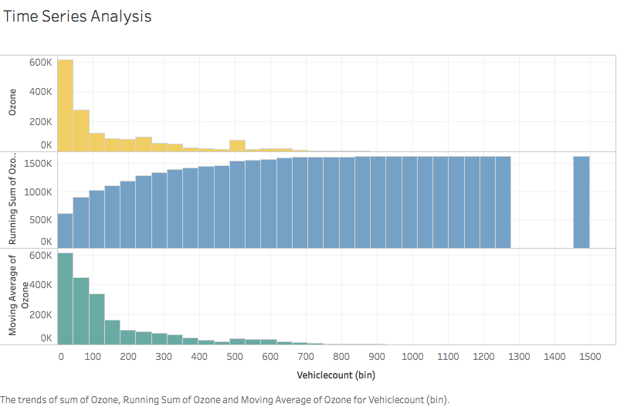
Quantitative Results 1
Understand the impact of the Vehicle Count on the ozone layer.

Slide 7
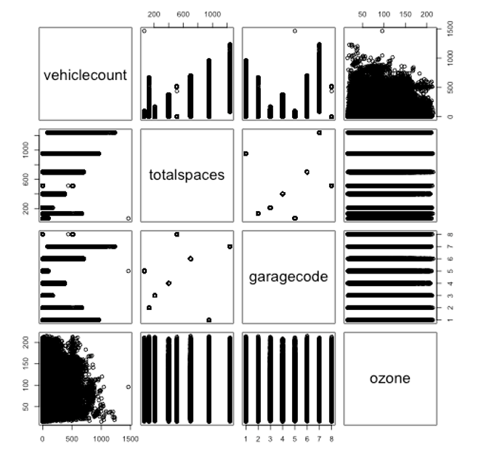
Quantitative Results 2
Impact of total spaces on ozone layers.

Slide 8
Discussion: Comparison With Your Competitor
Competitor’s Results
Your Results
The results focused on reducing the search and wait time for parking in a particular area in the city.
It helps reduce the other drawbacks of the previous systems like fake parking requests, user identification.
The results also depicted that the proposed system of parking will be helpful in managing the parking in an effective way.
Our results focused on identification of the parameters which impacted the ozone layer on the parameters.
Our linear regression model help us understand the relationship between the independent and dependent variables.
The time series helped us understand the impact of each of our variables on the ozone later.

Slide 9
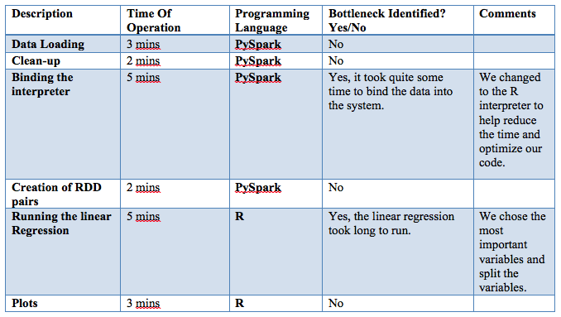
Performance on Big Data: Time Measurements

Slide 10
Conclusion
From our time series analysis we can identify the parameters which were the main parameters which impacted the ozone layer .
These analysis will be help build better parking infrastructure, identifying the traffic pattern in around the area, regulating parking prices and also proper traffic management
Future Scope
We can use the systems and the analysis by connecting it to the Global Positioning system to identify the areas where the pollution is high and also help reaching the driver reach his or her parking slots fast.

Slide 11
Quiz for Your Classmates
What statistical method was used?
What programming tool was used?
What scientific contribution was made?
What idea could be useful for your project?

